Slide 1

Misinformation Identification: Knowledge
Graph based RAG Technique
Submitted by,
Jimmy Aghera
Department of Computer Science and Engineering
Submitted to,
Prof. Durga Toshniwal
Department of Computer Science and Engineering
Notes:
175th IITR

Slide 2
Contents
Introduction
Problem Statement
Literature Review
Experiments
Research Gap
Proposed Methodology
Gantt Chart
References

Slide 3
Introduction
The rapid spread of false information on social platforms leads to social unrest, public confusion, and critical health-related consequences.
A Retrieval-Augmented Generation (RAG) and Large Language Models (LLMs)-based solution that retrieves data from trusted sources to fact-check and verify content can help to solve this problem.
This methods delivers a scalable and efficient system, which is capable of handling large volumes of data and preventing misinformation.

Slide 4
Problem Statement
The rapid spread of misinformation on social media, combined with dynamic and evolving content, challenges traditional detection methods. So, need of automated misinformation identification is in need to counter misinformation as fast as possible.
Existing detection methods, reliant on manual efforts or basic keyword filtering, fail to address the complexity and scale of modern misinformation campaigns, which often leverage AI, bots, and data-driven targeting. Therefore there is need of an automated, scalable, and accurate system to identify and mitigate misinformation on social media, thereby preserving the integrity of online communication and safeguarding societal trust.

Slide 5
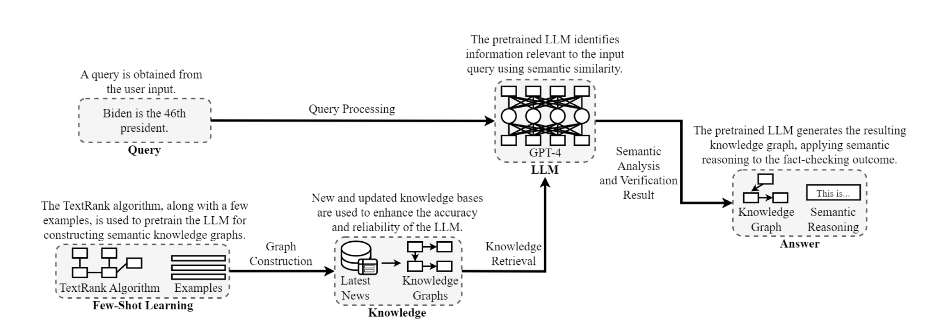
Literature Review 1
TrumorGPT
Figure 1: The architecture of TrumorGPT, showcasing the workflow from user input to fact verification.

Slide 6
Literature Review 1
In TrumorGPT technique, graph generation is done with the help of data, having data source as DBpedia.
Then the relevant graph is searched(community) with the help of similarity search technique and then feed into pre-trained LLM model along with the query.
By checking the edges and vertex which will lead to sentence generation, it will give result for a given social media post is true or false.
Accuracy for this approach was 90.5% for the dataset of 100, having 2 labels named as True and False.

Slide 7
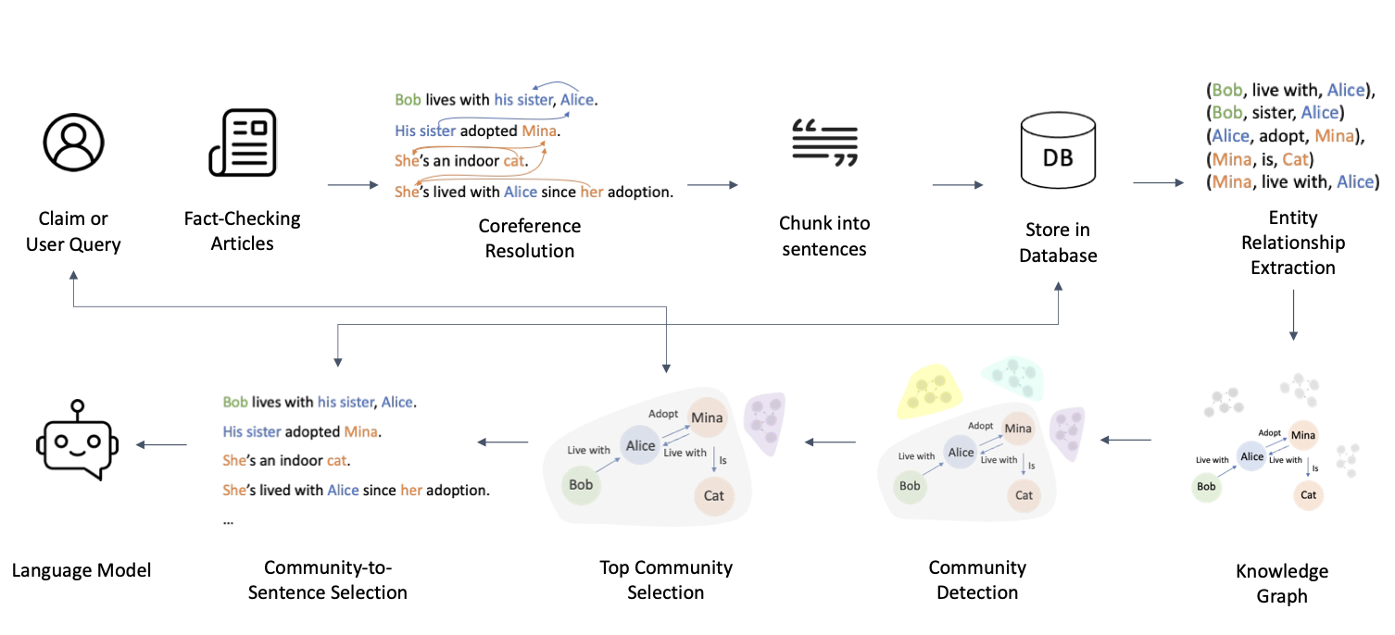
Literature Review 2
KG-RAG
Figure 2: Workflow of Community KG-RAG

Slide 8
Literature Review 2
In KG-RAG technique also same as TumorGPT it tries to use knowledge graph technique, but the data is taken from debunking website like Factcheck, etc
Other then that they are using community based retrieval instead of direct searching with GQL, which first identify top community of graph and then find top relationship among that community based searching is done.
Accuracy for this approach was 56.24% for the dataset of 18,553, having 3 labels named as Supported, Refuted, NEI.

Slide 9
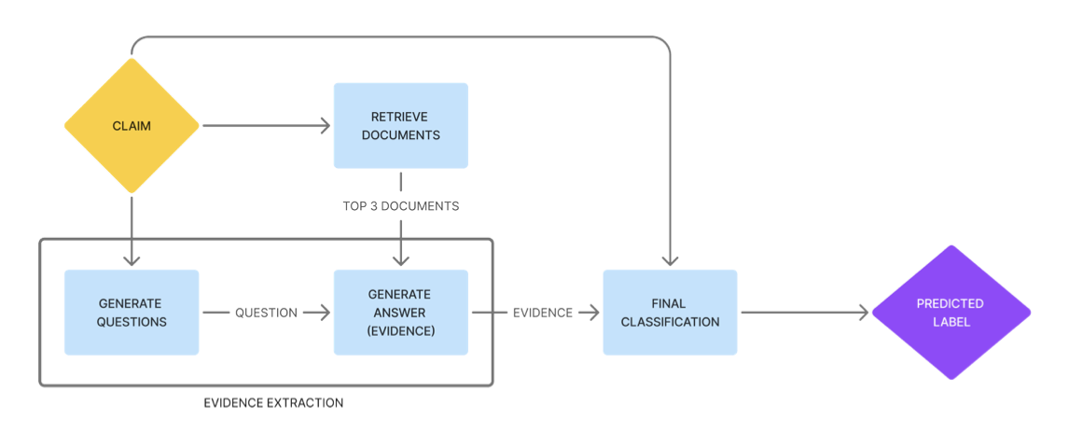
Literature Review 3
Evidence-backed Fact Checking using RAG and Few-Shot In-Context Learning with LLMs
Figure 3: architecture

Slide 10
Literature Review 3
This methodology take help of basic RAG technique and In-context learning for solving the fact checking problem.
Here they have used Averitec dataset having multiple labels like Support (S), Refute (R), Conflicting Evidence/Cherrypicking (C), or Not Enough Evidence (N).
Accuracy for this approach was 63.6% for 500 labeled data.

Slide 11
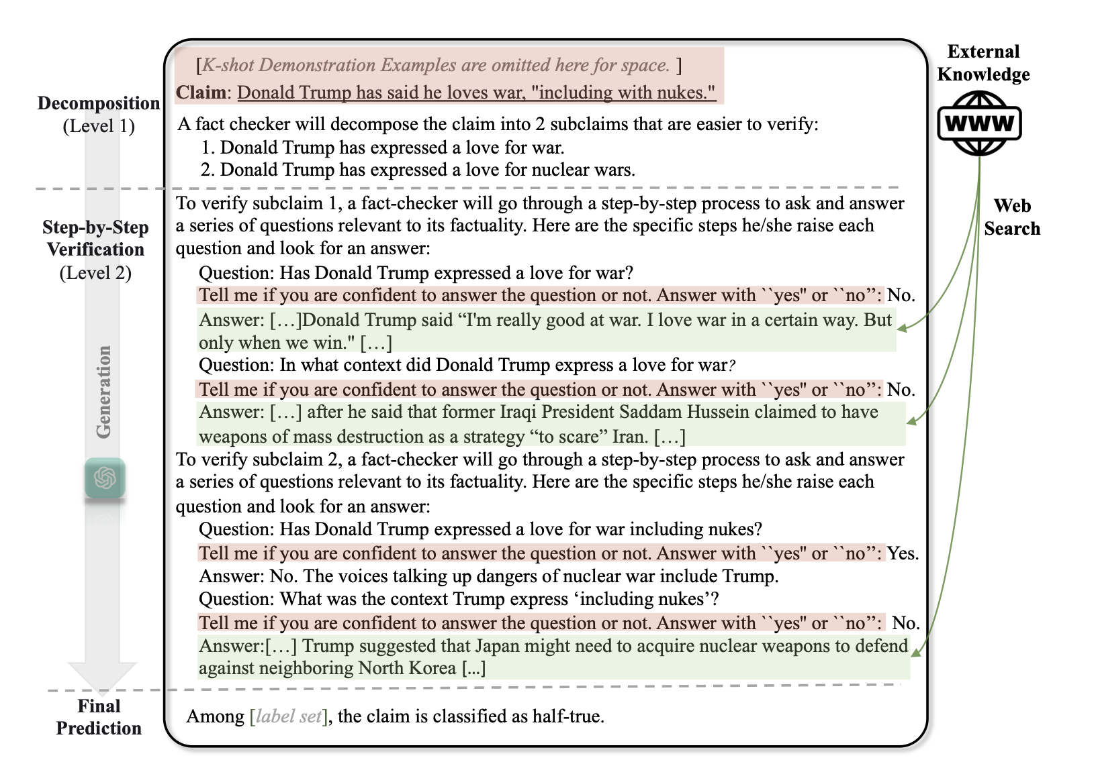
Literature Review 4
HiSS
This technique uses subclaim based approach which then checked individually with the help of external search.
This methodology is completely based on ICL/prompting method, which can be challenging when user input counter statement along with the query for PT-LLM.
F1 score for this techniques was shown to be 53.9 on RAWFC dataset
Figure 4: HiSS architecture

Slide 12
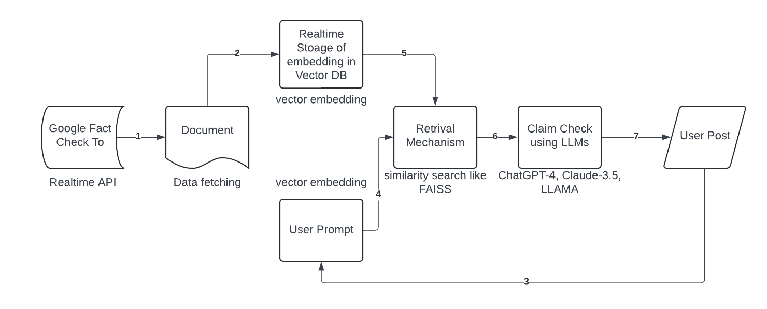
Experiments
Figure 5: Basic RAG technique

Slide 13
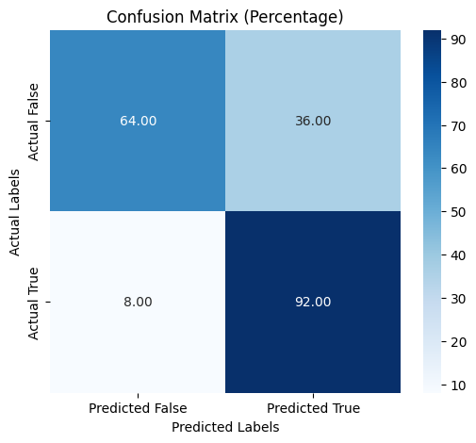
Experiments
The testing of Politifact data was done to check the issues with RAG and this experiments shows that claims which were marked false are more likely to be predicted as true.
Accuracy: 78.00%
Precision: 71.88%
Recall: 92.00%
F1 Score: 80.70%
The major reason behind this inaccuracy was of astroturfing lie in between true claims.
Figure 6: Confusion Matrix

Slide 14
Experiments
When analysed the data which were having type-I error it was found that most of those claims were using techniques like "astroturfing" or "disinformation sandwiching". Example is as shown below
Nine different subsidies that the U.S. government gives to an industry that makes more money than any other industry, including refunds for drilling costs and refunds to cover the cost of searching for oil. Subsidies for oil and gas companies make up 88 percent of all federal subsidies. Just cutting the oil and gas subsidies out would save the U.S. government $45 billion every year.
In the above claim all the statement are correct except last one, instead of “every year” its is “ten years”. This kind of techniques are widely used on social media, to counter this Agentic RAG can be helpful.

Slide 15
Research Gap
Overall it has been shown that graphRAG based techniques have shown higher accuracy over normal RAG based techniques.
In the Graph RAG techniques shown above there are two major problems
1. As time passes by the knowledge graph become much bigger and the relevant community detection in the graph become time consuming process.
2. Also, not use of multiple tools can lead to less accuracy on claims based on numerical calculations
3. Lack of early detection of claims, as rely on fact-checking website.

Slide 16
Proposed Methodology
In this method the claim is divided into multiple atomic claims, then the evidence gathering is done with the help of web search tools along with mathematical tools to check that retrieved document is sufficient the aviratic score is generated during training.
Then to Knowledge Graph is generated for the evidence gathered with the help of tool like Neo4j, after that alpha top-community(sub-graph) is identified and then after the relevant beta top-sentences will get identified. In Last step with the help of ICL technique the top sentence and the user post will be imputed to identify claim as refuted/supported or partial supported.

Slide 17
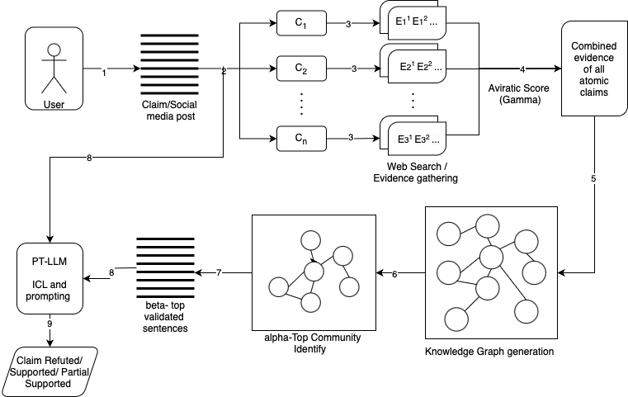
Figure 7: Work Flow of proposed Methodology

Slide 18
Proposed Methodology
Example Workflow of a Claim:
Input Claim: "Donald Trump has said he loves war, including with nukes.”
Decomposition:
Sub-claim 1: "Donald Trump has expressed a love for war."
Sub-claim 2: "Donald Trump has expressed a love for nuclear wars."
Reasoning by graph:
Donald Trump → President → USA , Donald Trump → loves → war ,
nuclear wars → Japan , etc
Output:
Combined analysis: "Partial Supported"

Slide 19
Gantt Chart
 | January | February | March | April | May
Implementation of proposed methodology
Testing on Dataset, Analysis of result
Comparison with other methodology
Documentation
Figure 8: Gantt Chart

Slide 20
Reference
[1]. Choi EC, Ferrara E. Fact-gpt: Fact-checking augmentation via claim matching with llms. InCompanion Proceedings of the ACM on Web Conference 2024 2024 May 13 (pp. 883-886).
[2]. Zhang Y, Sharma K, Du L, Liu Y. Toward Mitigating Misinformation and Social Media Manipulation in LLM Era. InCompanion Proceedings of the ACM on Web Conference 2024 2024 May 13 (pp. 1302-1305).
[3]. Singal R, Patwa P, Patwa P, Chadha A, Das A. Evidence-backed Fact Checking using RAG and Few-Shot In-Context Learning with LLMs. InProceedings of the Seventh Fact Extraction and VERification Workshop (FEVER) 2024 Nov (pp. 91-98).
[4]. Chang RC, Zhang J. CommunityKG-RAG: Leveraging Community Structures in Knowledge Graphs for Advanced Retrieval-Augmented Generation in Fact-Checking. arXiv preprint arXiv:2408.08535. 2024 Aug 16.

Slide 21
Reference
[5]. Hang, Ching Nam, Pei-Duo Yu, and Chee Wei Tan. "TrumorGPT: Query Optimization and Semantic Reasoning over Networks for Automated Fact-Checking." 2024 58th Annual Conference on Information Sciences and Systems (CISS). IEEE, 2024.
[6]. Zhang X, Gao W. Towards LLM-based Fact Verification on News Claims with a Hierarchical Step-by-Step Prompting Method. InProceedings of the 13th International Joint Conference on Natural Language Processing and the 3rd Conference of the Asia-Pacific Chapter of the Association for Computational Linguistics (Volume 1: Long Papers) 2023 Nov (pp. 996-1011).

Slide 22
Thank you

